Slide 1
2025 ManSask Summer Long Course Championships
Technical Meeting
10 July 2025
Winnipeg, MB

Slide 2
INTRODUCTION
Meet Referee
Para Technical Advisor
Meet Manager
Meet Manager
Entry Coordinator
Officials Coordinator
Michelle Neilson
Sandra Rousseau
Ken Barnes
Dale Gustafson
Cam Harbeck
Nancy Champagne

Slide 3
SAFE SPORT SEE SOMETHING, SAY SOMETHING
Swimming Canada believes that everyone in the sport has the right to enjoy the sport at whatever level or position they participate. Athletes, coaches, officials and volunteers have the right to participate in a safe and inclusive training and competitive environment that is free of abuse, harassment or discrimination.
To report an incident during the event, please contact Dale Gustafson (Meet Manager)
To report an incident after the event, please contact Bruce Rose (Executive Director Swim Manitoba)
For more information: https://www.swimming.ca/safesport/

Slide 4
START TIMES
Prelims (2 x pools, 8 lanes):
Warmup: 7:30 – 8:55am
Start Time: 9:00am
Finals (Main Tank, 8 lanes):
Warmup: 4:00 – 5:20pm
Start Time: 5:30pm

Slide 5
ESTIMATED TIMELINES
Prelims Finals
Thu: (T)8:21pm/(M)8:48pm n/a
Fri: (B)11:03am/(G)12:16pm 8:43pm
Sat: (B)11:36am/(G)12:13pm 8:28pm
Sun: (B)10:53am/(G)11:51am 7:37pm

Slide 6
PRELIMS POOL CONFIGURATION
Thursday 1500m > Trg Tank remainder > Main Tank
Note: Order will be Girls 200IM, Boys 200IM, Para, Relays
Friday Girls > Main Tank Boys > Trg Tank
Saturday Girls > Trg Tank Boys > Main Tank
Sunday Girls > Main Tank Boys > Trg Tank

Slide 7
EVENT START
Main Tank
100m and longer will start from the Dive Tower end
50’s will start on the bulkhead
Training Tank
All events will start from the start end (under scoreboard)

Slide 8
WARM-UP LANE BREAKDOWN
Main Tank
Lane 1 >> Para swimmers
Lane 2 & 7 >> Sprint Lane – one way from start end (last 45 mins)
Lane 8 >> Pace lane during all of warmup
Training Tank
Lane 1 & 7 >> Sprint Lane – one way from start end (last 45 mins)
Lane 8 >> Pace lane during all of warmup

Slide 9
WARM-UP LANE BREAKDOWN
During prelims: warm up/down is in open area past Main tank
During Finals: warm up/down is ONLY in the Training Tank during which Lane 1 will be for Para Swimmers. The open area on the other side of the Main tank bulkhead is out of bounds
Prelims: swimmers are to warmup in the pool that they will be competing in
Finals: only swimmers competing during that session are to use the Main tank during warmups

Slide 10
WARMUP PROCEDURES
Violation
Swimmers witnessed entering the water in a dangerous fashion may be removed from their first individual event
Second offense in same competition, may be removed from the remainder of the competition
Permitted
Kick board, pull buoy, snorkel & ankle band

Slide 11
COMPETITION MANAGEMENT
OLYMPIC PROGRAM
Pool will be cleared between events in prelims & between heats in finals
Swim Offs: will take place during the session in which the tie occurred. Swim Offs may take place in an alternate tank depending on timeline
FINALS SEQUENCE: A Final, B Final
B Finals will only occur for events 400m and under with 20 or more athletes entered at entry deadline

Slide 12
COMPETITION MANAGEMENT
PARALYMPIC PROGRAM
All Para swimmers will clear the pool after each heat with two short whistles by the Referee
Swim Offs: will take place during the session in which the tie occurred
As per Meet Pkg, following events are combined:
150/200 IM, 200/400 Free, 50/100 each Fly/Back/Breast
FINALS SEQUENCE: A Final Only

Slide 13
COMPETITION MANAGEMENT
400m IM
The fastest heat for each gender will swim in finals
The slower heats will swim in prelims, slowest to fastest
800m/1500m
All heats will swim in preliminaries, fastest to slowest
1500m will alternate genders

Slide 14
COMPETITION MANAGEMENT
OFFICIAL SPLIT REQUESTS
Official Split request form is available at the Admin Desk
Must be received no later than 30 minutes before start of session

Slide 15
RELAYS
4x50 Mixed Medley (Thu) – relay cards with names are due to the Admin desk by 5:00pm
4x50 FR (Fri) & 4x50 MR (Sat) – relay cards with names are due to the Admin desk by 30 Minutes after end of the Prelim session on the day of the relay
Final relay orders may be updated through the Admin Desk up to 30 minutes before start of the Finals session in which it will be held

Slide 16
PROVINCIAL RELAYS
Cards for all Provincial Relays are due no later than 15 minutes after the conclusion of the Final of Event #44 (50m Backstroke)
Further details on selection process is contained in the meet package
Para Provincial Relay: if there are not enough Para swimmers within a Province to enter a team, this can be changed to Para Relay to allow athletes to compete. Further coordination to follow

Slide 17
CALL ROOM PROCEDURES
Finals Sequence: A Final, B Final
Swimmers (All A, B Finalists & Alternates) must report to the Call Room 15 minutes before scheduled start of the A Final of their event
A Finalists will be introduced while marching on
B Finalists will be released from the ready room for their event and should be ready behind the blocks. They will be introduced during the race

Slide 18
CALL ROOM PROCEDURES
If a swimmer has not reported to the Call Room in the specified time, an announcement will be made for them
If a swimmer has still not reported by 5 minutes prior to the start of the A Finals for their event (by age), they WILL be replaced by an alternate
Finals Back-To-Back Events (within 30 minutes)
Coaches must fill out a Call Room Special Request Form that can be found at the admin desk
This must be filled out before the completion of warmups

Slide 19
SUPPORT STAFF
Para swimmers may have support staff designated to assist them on deck or in the call room. Please note:
WPS 10.8.1 Support Staff are not permitted to coach or massage Athletes. When on the pool deck or in the call room, Support Staff are not permitted to use or visibly carry stopwatches, radio communication devices, backpacks or bags
Violation of this rule may result in the swimmer being disqualified

Slide 20
TAPING REVIEW PROCEDURES
As per II.C15.3.2, a Taping Review Committee will oversee taping requests
Review Protocol: All taping must be reviewed before the first session where it will be used. If identical taping is used for multiple sessions, review is required only once. Taping review for a Para swimmer will be done by the TA
Submission Protocol: Coaches must submit a Taping Review Form the Admin Desk, no later than:
• 8:00 am (before prelims) • 4:30 pm (before finals)
Review will be conducted during warmups. Both swimmer and coach must attend, and swimmer must have the taping in place. Approved taping will be photographed to allow verification after each race

Slide 21
TAPING REVIEW PROCESS
Prelims: Swimmer must report to the Admin Desk immediately after each race to verify taping. Swimmer must remain at the Admin Desk until Post-Race Tape Check is completed and signed off
Finals: Referee will meet the swimmer as they exit the pool for taping to be verified prior to the scoreboard being declared “official”
Committee's decision is final. Swimmers using unapproved taping will be disqualified
Any swimmer wearing taping that is not approved by the Committee is ineligible to set a Canadian Record

Slide 22
PARA SWIMMING DEVICES
Tapping and starting devices must be deemed safe. They must be checked and issued an approval sticker following this Technical Meeting. Please see Sandra Rousseau
Any altered suit must be approved by the Para Swimming Technical Advisor – Sandra Rousseau

Slide 23
BACKSTROKE LEDGES
Field of Play will install the device
• The IT will ensure the device is set at 0 initially
• The IT will check the strapping is free of any twists or knots and that the ledge is sitting flat against the wall
• Once the athletes arrive behind the block the athlete may change the setting and ensure it is secured into position or may remove it from the water if they do not wish to use the device. The IT may be asked for assistance
• Reminder: at least one toe from each foot must be in contact with the touchpad. ITs will provide an instruction if necessary

Slide 24
HEAT SHEETS & RESULTS
Prelims and Finals Sheets:
Available in the office daily for coaches
Posted on ManSask webpage as soon as they are ready
What’s App announcement when ready
Results:
Unofficial on Meet Mobile
Posted on webpage after session

Slide 25
MANSASK WEBPAGE
ManSask.live/home
If you believe that something should be there that isn’t, please refresh your screen
Finals Livestream link is on the webpage and here:
ManSask.live/watch

Slide 26
SCRATCH PROCEDURE
Deadlines:
Day 1 Prelims & Timed Finals:
30 minutes following the conclusion of the Technical Meeting
Day 2 – 4 Prelims & Timed Finals:
6:30 PM during Finals the previous evening
Finals:
30 minutes following preliminary events of the day, excluding timed finals events
Scratches must be completed on forms available at the Admin Desk. ONE swimmer per form please

Slide 27
POSITIVE CHECK-IN
400m IM
Check-in must be done by the conclusion of warm-ups on Sunday morning to determine the 8 swimmers that will swim in finals
800m/1500m Free
Check-in must be done by the conclusion of warm-ups for the scheduled session. These events may be re-seeded

Slide 28
POSITIVE CHECK-IN
Finals
Due to the utilization of the call-room at finals, there will be no positive check-in required
However, coaches are encouraged to advise the Admin Desk of a late scratch as this allows preparation for the possible insertion of alternates

Slide 29
PENALTIES
Failure to check-in by the deadline for 400 IM, 800/1500 Fr will be deemed a scratch and the swimmer will be removed from the event with no monetary penalty except loss of entry fee
Penalty for not scratching FINALS:
The swimmer will be scratched from all remaining final events, including relays, for that day
The relay team that includes that swimmer will be prohibited from swimming

Slide 30
DQs AND PROTESTS
DQs will be announced during prelims
DQs will be placed on the board results during finals
Procedure for Protests
Discuss DQ with Session Referee
If not resolved, a written protest may be presented to the Ref within 30 minutes of the conclusion of the event (protest forms available at Admin Desk)
If not resolved after discussion of the written protest, the matter may be assigned to a Jury of Appeal

Slide 31
JURY OF APPEAL
Chaired by the Meet Manager or Meet Referee
1 coach selected to be least biased to the swimmer involved and no vested interest
2 or 4 officials

Slide 32
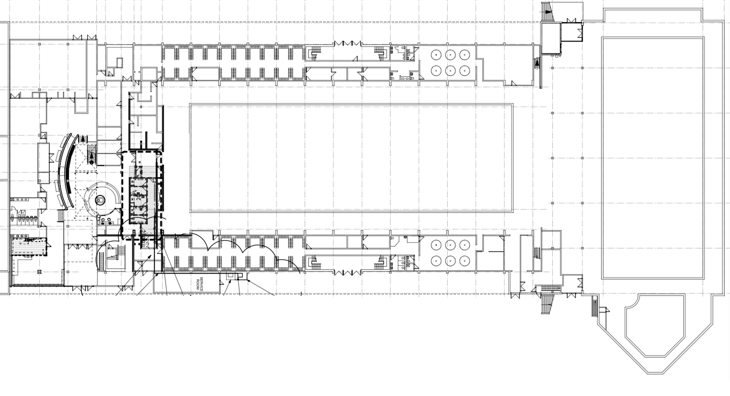
-2ND FLOOR-
AQUATIC HALL OF FAME
(SEATING/ CONCESSIONS / VENDOR)
SPECTATOR SEATING
TEAM & ATHLETE SEATING
EAST (TRAINING) TANK
MALE LOCKER ROOM
UP
START END
REFEREE
READY ROOM
MEET OFFICE
MAIN TANK
WARM DOWN LANES
PODIUM
UP
START END
50 M and 150M
START END
OFFICIALS BREIFING ROOM
WASH ROOMS
REFEREE
COMISSION
ADMIN
HOSPITALITY
FEMALE LOCKER ROOM
UP
SPECTATOR SEATING
TEAM & ATHLETE SEATING
ENTER

Slide 33
EVACUATION PROCEDURES
Follow instructions from the lifeguards

Slide 34
AWARDS
Medals will be presented after each event
A “podium” with names will be on the scoreboard but not announced
Swimmers are to make their way to medal presentation & pictures
There will be minimal pause between events
Provincial age group awards and all other individual awards/trophies, and Club awards will be presented at the conclusion of events on Sunday

Slide 35
RECORDS
Meet Management will process all records
To assist, coaches are asked to speak to Meet Management prior to a record (if aware there is a potential), and after a record has been set

Slide 36

WHATS APP ANNOUNCEMENTS
Or use this link: https://chat.whatsapp.com/CcNxDku5kYNFH3ZUVQTnAP?mode=r_c

Slide 37
ADMIN DESK & CALL ROOM
Prelims: the Admin desk will be located in the Main tank near post #2
Finals: the Admin Desk will be located in the Main Tank near Lane 1
Finals: the Call Room will be located in the Main tank near Lane 8

Slide 38
GENERAL INFORMATION
All swimmers must please use the change room and not change on deck
Glass containers, breakables, and food are not allowed on deck
Clubs are responsible for their valuables and for the conduct of their swimmers
Please clean up your club’s areas in the stands and on deck before leaving each session

Slide 39
HOSPITALITY
Breakfast and Supper will be provided for coaches
Lunch is not available for coaches and is only provided for out-of-town officials

Slide 40
You have 30 minutes from now to submit scratches for tonight
HAVE A GREAT MEET!

